Slide 1
Conquering Complex Accommodations
Brought to you by Student Accessibility Support and the Center for Teaching & Learning
Student Accessibility Support at Brandeis University acknowledges our occupation of Massachusett, Nipmuc, and Pawtucket homelands and territories. We recognize that the very existence of our university in Waltham has been facilitated by the dispossession, enslavement, forced removal, and dispersal of Native communities by settler colonialism.
Notes:
Introductions

Slide 2
Goals for our time today:
Develop a shared understanding of the importance of disability inclusion as a matter of equity and justice
Discuss complex accommodations and how to manage them
Think about how to use principles of Universal Design for Learning to address accommodation pain points and reduce time spent on managing accommodations
Notes:
Thank you for intros
3 main goals
Participation options-
-Ask freely!
-On Zoom- Unmute and shout out, “raise hand”, drop it in chat
-Email me later (carastreit@brandeis.edu)

Slide 3
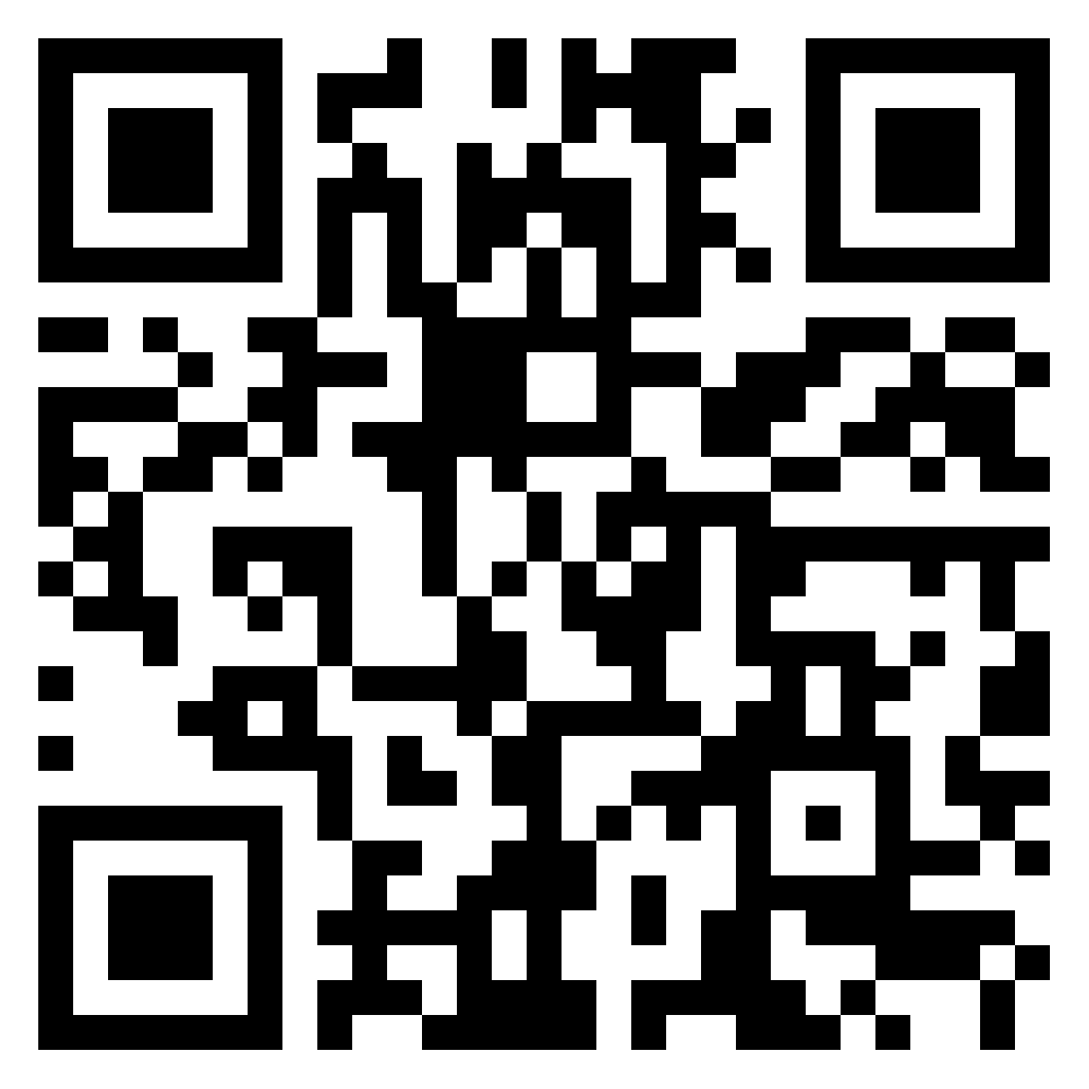
Share Accommodation Pain Points
Scan me to share your pain!
Think about accommodations or student needs that are particularly difficult to manage. These might be things that:
Take a lot of your time
Cause anxiety or confusion for students
Are emotionally draining
Are confusing, complicated, or frustrating for you
Notes:
Before I even share anything, I want to hear what your pain points are.
-Will help give our discussion a foundation in your real experiences
-Also Helps me to adjust our practices at SAS
Add a comment on padlet using the Pink circle with the plus sign

Slide 4
Foundational Concepts for Disability Equity
Notes:
Alright, we’ll be back to think about those pain points later, but as we’re going through our content, I want you to be thinking about your pain point or one that someone else raised that resonates with you, and consider how everything we’re discussing relates to that topic.

Slide 5
Meet Hannan, student leader of Deisvergent, the student Neurodiversity/neurodivergence affinity group
Notes:
To help center our work in our actual students, and who they are, and how they view all of this, I’m going to play a very short piece of a recording from a panel of students at Neurodiversity Celebration week last week, and this is our student Hannan talking about what it’s like for them as someone who is autistic and has ADHD.

Slide 6
Our responsibility for including students w/ disabilities in University spaces and experiences is guided by multiple federal and state laws (ADA & Amendments, Section 504 of the Rehabilitation Act of 1973, and the Fair Housing Act primarily).
Under the Americans with Disabilities Act a disability is:
Intentionally broad and inclusive as a civil rights law
"A physical or mental impairment that substantially limits one or more major life activity."
Notes:
Ok, so with ourselves centered on students, let’s get into what we can do for Hannan and many other students we work with.
{slide}
Life activities are basically everything that a human might need to do in a given day. Thinking, walking, talking, hearing, seeing, eating, breathing, digesting, writing, reading, sleeping; these are all major life activities, and conditions that impact someone’s ability to do those things in a substantial way are considered disabilities.
Intentionally broad

Slide 7
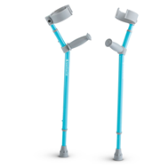
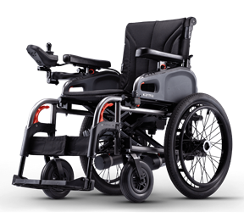
Communication
(eg Expressive communication & Social communication disorders)
20% of undergrads have documented disabilities for academic accommodations
Chronic Illness
(eg cancer, diabetes, lupus)
Neurological and Neurodevelopmental
(eg Autism, ADHD, epilepsy)
Sensory
(eg hearing, vision, and sensory integration)
Mobility, Fine & Gross Motor
(eg Cerebral palsy, injury, paralysis, connective tissue disorders)
Learning
(eg dyslexia, specific learning disabilities in math or reading)
Mental Health
(eg Depression, Anxiety, PTSD, OCD)
Notes:
All of these conditions can be considered disabilities and all of these are represented at Brandeis. 20% of undergraduate students at brandeis have documented disabilities for academic accommodations, that percentage would go up a bit if we included students who have disability-based housing accommodations without any academic accommodations. This is a high number not because there are more students with disabilities here than at other schools, but because more students with disabilities disclose them here than at most other schools for lots of reasons that I’d love to get into but we don’t have time.

Slide 8
Required under the ADA
“All the programs of postsecondary institutions, including extracurricular activities, must be accessible to students with disabilities. The schools can do this in several ways: providing architectural access to buildings, including residential facilities; by providing aids and services necessary for effective communication, like sign language interpreters, Braille or electronic formats and assistive listening devices; and by modifying policies, practices and procedures, such as testing accommodations and access to school facilities for service animals. Accommodations and program modifications should be individually designed to meet the needs of the student with a disability.”
Source: adata.org
Notes:
Ok so as a university and individual reps of the university, what are we required to do. I’m going to be a bit boring and just read this out directly, this quote comes from the ADA’s technical assistance center……
[read]
I bolded this last part, that Accommodations should be individual designed to meet the needs of the student with a disability. Now this is why you may see new accommodations you haven’t seen before, and it can also be why some of the letters for students with more complex needs can get a little long. There are many accommodations, like extended time on exams and notetaking support that are important for a large range of disabilities and so those show up on letters often. There are other sthat are very specific to a student, a condition, or to the classes a student is taking, and we are legally required to individualize the accommodations necessary to allow that student full access to campus experiences, we cannot say “no sorry, that specific thing you’re requesting isn’t on the menu here”, we have to work with them and with instructors to find something that works to get them equal access. And so I think it’s helpful to have this shared understanding of why some accommodations are very specific or complex.

Slide 9
When SAS meets with students we look at:
Their diagnosable “impairment”
The “major life activities” impacted by presentation of the impairment
The University experiences they are finding difficult to access as a result of the interaction between their impairment and how the experience is structured
How we can adapt or supplement the structure of those experiences to ensure full access, via “Reasonable Accommodations”
Notes:
So in our work at Student Accessibility Support, we look at a student’s diagnosable impairments, the life activities that are impacted by the way their impairments present in different environments, and we talk about the university experiences that they’re having difficulty accessing. Finally we look at how we can adapt or add to those experiences in order to ensure the student has full access to
Them, using “reasonable accommodations”

Slide 10
What is a “Reasonable Accommodation?”
A reasonable accommodation can be an added support, the removal of a barrier, an adjustment to a policy, or other modification of materials, practices, and spaces.
We are REQUIRED to consider all disability accommodation requests and determine what is or isn’t reasonable on an individual basis. The process for how we consider these requests is very important (legally and practically), and should always be done by SAS and not individual faculty.

Slide 11
What is not required
“Accommodations and modifications of policies and practices are not required when it would fundamentally alter the nature of the service, program, or activity or give rise to an undue financial or administrative burden.”
The bar for “an undue financial burden” is VERY HIGH and rarely reached by an organization of this size; it’s hard to make a case for administrative burden as well. However, accommodations have been denied based on being a fundamental alteration.
Source: adata.org
Notes:
All that said, not everything is required or approved.
Accommodations and modifications of policies and practices are not required when it would fundamentally alter the nature of the service, program, or activity or give rise to an undue financial or administrative burden.
there’s almost never a situation where we deny something on financial grounds because that’s been show in case law over and over not to stand up in court with an institution with the kinds of resources we have here, and an administrative burden case is pretty hard to make as well. We do sometimes determine that requests are not reasonable on the grounds that they fundamentally alter a program.

Slide 12
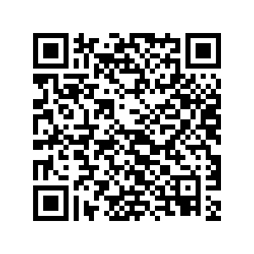
Fundamental Alterations
A fundamental alteration changes the essential requirements of a course or program, including the content and objectives. Essential requirements are the core learning outcomes (including skills and knowledge) all students must demonstrate.
Contact access@brandeis.edu if you think this applies to an accommodation in your course.
Process for assessing a possible fundamental alteration—---->
Notes:
https://www.brandeis.edu/accessibility/pdfs/reasonable-accommodation-guidance.pdf

Slide 13
Case Example- Meet Cara at 18 years old!
Impairment: Social Anxiety Disorder, Generalized Anxiety Disorder, & Depression
Major Life Activities: Communicating
Difficulty Accessing: Student life activities, verbal participation in class, class presentations, verbal interactions with professors
Notes:
Ok so let’s apply all this to a real person so you can see how it all works on our end- Here’s sweet little 18 year old Cara when I was a nervous pre-med biology major at Boston College. I have Social anxiety disorder and some associated general anxiety and depression, and while I’ve got some strategies in place now to navigate the world with relative ease, that was not the case when I was in my college years as a first gen student in the city with parents from a super rural area who didn’t believe in mental health care. The major life activity I struggled with the most was oral communication. This caused the most difficulty for me in participating in student life activities, so I didn’t, in asking questions in class, so I didn’t, and in doing in class presentations, which I just had to do, but which would lay me out for a week because of the anxiety level I had at the time about talking to literally anybody. To this day, this is not something I do easily and I’m going to need all weekend to recover from this 1 hour and the emotional preparation that went into it; back then, woof. Tough stuff.

Slide 14
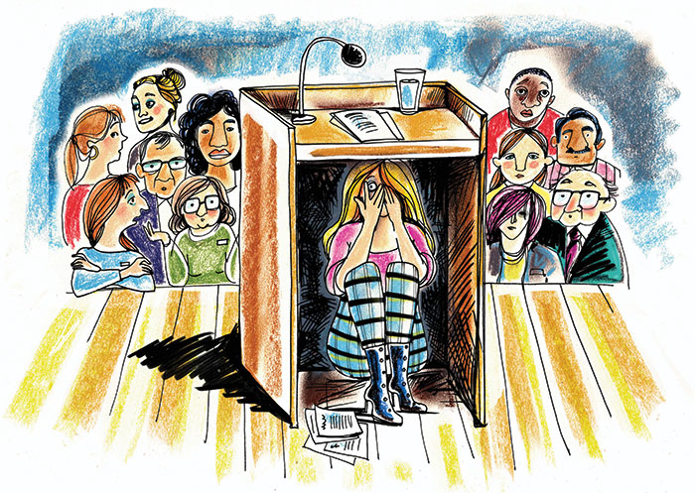
Reasonable Accommodations:
Alternative in-class participation options
No cold calling
Alternative to live in-class presentations
This would not be reasonable if the class meets an oral communication requirement or if development of public speaking skills is an essential part of the class learning outcomes.
Notes:
So for 18 year old Cara, what would have helped me access classes more equitably would’ve been alternatives to in class participation, so possibly using an online discussion board had such a thing existed, to share my questions and comments in a text based format, no cold calling (and I know that’s a hot button one sometimes here so we can dive into how to work with that if anyone wants to raise it up later) and then for most but not all classes, alternatives to live in-class presentations.
Now-not all of these accommodations would be reasonable for a language class or classes that meet an oral communication requirement or if development of public speaking skills is an essential part of the class learning outcomes. Replacing a traditional live in class participation could be a fundamental alteration of a small number of classes. But, for most classes, alternatives could be possible. Importantly, we aren’t excusing the purpose of the exercise, which would be to demonstrate knowledge of the content area, the accommodation would be offering other ways for that to be done for this student.

Slide 15
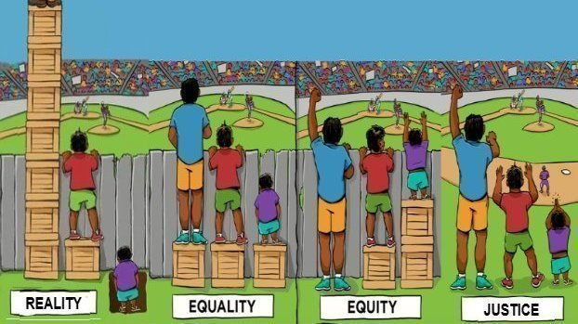
Required under federal law
(Adaption of work by Interaction Institute for Social Change | Artist: Angus Maguire)
Notes:
So let’s ground accommodations into this familiar graphic, some of you have probably seen this 100 times in different variations. I like this one because it starts with the reality that everyone is starting from a different place. We’ve got students who had private tutoring their whole lives and have no disabilities or socioeconomic disadvantages and their parents are lovely and accepting and they’ve got more boxes to stand on than they could ever need. Then we’ve got sort of average joe in the middle, basically has what they need, doing ok. Then we’ve got the student with a chronic health condition who has to keep going to urgent care or the ER and missing class, and they don’t have family support and they can’t afford the inhaler they need, and they have to work a campus job to put themselves through school and oh by the way they also have ADHD and we’ve got national shortage of ADHD meds so they can’t get a thing done to save their life. So purple shirt person is starting below everyone else essentially. Teaching everyone the same way and expecting it to work completely disregards this reality, and that’s section two here. Even if everyone has the same things inside a class, the same box for everyone or “equal treatment”, this person on the end still can’t access the baseball game. He has an unfair disadvantage and by giving him the same as the people next to him, you’re preventing him from participating and seeing the game. Equity is the third section, and that’s everyone getting what they need in order to have the same level of access.
The third panel is equity. Equity is what’s required by the ADA. here we’ve given the purple shirt person an additional box to stand on, and that box represents an accommodation. It’s an adjustment we can add into the current system to improve access for students who are disadvantaged by the intersection of the way their disability presents and the environment they’re in. one minor critique I have with this image is that it sort of looks like we’re taking boxes away from the privileged person and that’s not what we’re doing with accommodations- it’s not taxes and social welfare programs here, we aren’t taking anything away from tall blue shirt guy so there’s no need to worry about them.
Now, in this last panel, we have justice, sometimes framed as liberation. The fence is a barrier; removing the barrier corrects the inherent inequities in the system to make it work better for those who are otherwise disadvantaged or oppressed, without negatively impacting others, and sometimes even helping them, too. In our teaching, we can do this by using Universal Design for Learning principles to design our classroom experience without fences or barriers between students and the content and skills we want them to learn. You’ll notice that without the barrier, short person with the purple shirt doesn’t need an accommodation anymore. Now, being realistic, none of us can design a class that is so broadly and flawlessly inclusive that nobody will ever need any accommodation, but by using Universal Design to re-think pieces of a course where accommodations are the most difficult to manage, we can remove the barriers for most of our students and reduce the overall time and impact of many academic accommodations.

Slide 16
Learning Outcome
Activity that presents a barrier when it intersects w/ an impairment
Accommodation
(Adaption of work by Interaction Institute for Social Change | Artist: Angus Maguire)
Notes:
Ok so bringing 18 year old me into this visual aid, the baseball game is the learning outcome you as the instructor are trying to help me achieve and show my understanding of when you assign an in-class presentation. The fence is the barrier a student might experience to demonstrating that learning outcome as a result of how their impairment intersects with the structure of the assignment. So for 18 year old me, a requirement to present in front of the class for 30% of my final grade is an automatic barrier to me showing my progress on the learning outcome you’re trying to assess. I may know everything in the world about the topic and could write it all up for you beautifully, but if I had to present it at 18 before I finally got to the point I’m at today, I would seem like I knew nothing, and I wouldn’t have an equitable way to be assessed on my learning. If being able to present orally in front of the class is NOT the actual skill you want to measure, a reasonable accommodation would be to allow me to show my acquisition of the learning outcome in a way that works better for me, without fundamentally changing the purpose of the activity. So you might let me create a presentation and record it privately to show in class or to share individually with you, you might let me create a slideshow and just do a voiceover to it that I play for the class, maybe I write a paper— the topics and prompts can all be the same, and you can use a rubric that looks at the actual content knowledge demonstrated and specifically assesses that regardless of the vehicle- it’s just the method of engagement and assessment that changes.

Slide 17
Accommodating or Enabling?
Are accommodations an unfair advantage?
NO. Accommodations reduce unfair DISadvantages.
Do they encourage unhealthy avoidance?
NO. Your class is not therapy and it’s not an academic responsibility to expose them to their triggers to help them build resilience.
Do they prevent the development of key skills?
NO. They create access to content and experiences the student would otherwise have to struggle through even more significantly, giving them more time and space than they otherwise would have had to develop necessary skills.
Notes:
Now some folks will worry that accommodations action enable bad academic behavior by students or harm them in some other way. They really honestly don’t unless we’ve made a mistake, and that’s possible but we’re pretty good so let’s assume we’ve done our jobs right, and the accommodations we’ve laid out really are the ones this student needs.
[slide]
You don’t have to be responsible for teaching coping skills or organizational skills even though it can feel like it’s necessary with some of the students you see in front of you. Don’t make life lessons out of academic lessons when it comes to disability accommodations. Leave the long term coping and organizational skill development to my office and the BCC and SSSP and other programs that are here to handle those aspects and are with students for. You supporting their accommodations in class is helping, not hurting, full stop.

Slide 18
Accommodations support equity
Universal Design for Learning supports justice, reducing the need for accommodations
Remember, a reasonable accommodation can be an added support, the removal of a barrier, an adjustment to a policy, or other modification to the way things are usually done. They are not unfair advantages, they are reductions of unfair disadvantages.
In our setting here at Brandeis, we need both accommodations and adoption of UDL-oriented practices to ensure equity while making progress toward justice
Notes:
While we’re legally required to put in place accommodations to achieve equity, getting short purple shirt person to see over the fence, we should be striving for justice, taking down the fence. Accommodations are individual supports that help people start from different places and still access the same goal, while Universal design or Justice would be structuring an experience where people can start from different places and still all have opportunities to access the same goal, without anything special for just the one person or few people.
So achieving equity in my case example would be allowing me to demonstrate my knowledge in a way other than a class presentation, while justice would be giving all students a choice in how they demonstrate knowledge from the beginning, so that all students have multiple options and can choose what’s best for them rather than having a standard format with exceptions for just a few particular students. This is important because you very likely have other students in your classes who are disadvantaged by one particular format of assessment, and you may only know about the one who is working with our office and that other student is not getting any specific support around their barriers. That’s why Universal Design is superior to just implementing individual accommodations as exceptions.

Slide 19
Universal Design for Learning
Notes:
Alright moving on to the meat of UDL

Slide 20
What is Universal Design for Learning?
“An educational framework that guides the design of learning goals, materials, methods, and assessments as well as the policies surrounding these curricular elements with the diversity of learners in mind.”
-CAST, UDL On Campus
Notes:
UDL is “An educational framework that guides the design of learning goals, materials, methods, and assessments as well as the policies surrounding these curricular elements with the diversity of learners in mind.”
So UDL is a way of designing learning experiences that integrates choices and multiple methods of sharing information, engaging with it, and assessing knowledge to ensure that students have ways to learn and show their learning that work for them, with less need for specific accommodations. So it’s very much about variety and learner choice.
Is it really universal?
Well, no. BUT, it’s a practice of intentionally making your pedagogy as accessible as possible for your students.
Don’t let the size of the term “Universal” deter you from trying. Small steps can have big impacts. It’s an interactive process that gets easier as you do it, and it doesn’t have to be all or nothing to start with. You can choose a specific problem you’re experiencing and re-design just that using UDL principles and that’s important and great.
All of what we’re about to cover comes from the CAST higher ed website, http://udloncampus.cast.org/home Which is the major authority on UDL and a great resources as you explore these concepts.

Slide 21
What are the goals of UDL?
To give all students equitable opportunities to learn
To reduce the need for individual accommodations and exceptions
To improve student engagement and retention
To ensure students can show what they know
Notes:
The goals of UDL are
To give all students equitable opportunities to learn
To reduce the need for individual accommodations and exceptions
To improve student engagement and retention
To ensure students can show what they know

Slide 22
Notes:
Now in the spirit of universal design I’m going to show you a quick video about the core principles of UDL and then we’ll recap those in the next slides. And the link to this video is also in the padlet for future reference.

Slide 23
What are the core principles of UDL?
Multiple means of engagement (how learners interact with the lesson and build motivation)
Multiple means of representation (how information is presented)
Multiple means of action and expression (how learners practice and show what they know)
Notes:
So as we just saw in the video, Designing learning experiences with UDL requires attention to 3 core principles-
Multiple means of engagement (how learners interact with the lesson and build motivation)
Multiple means of representation (how information is presented)
Multiple means of action and expression (how learners practice and show what they know)
We’re going to break these down further in the next couple slides.

Slide 24
What do the core principals look like in action?
Engagement- Offer choices in readings, how to participate in class, how to attend class, what to research, etc. This is about building motivation.
Representation- Offer multiple ways to take in information, making sure all formats are fully accessible. Captioned videos, infographics with text descriptions, podcasts, readings, class discussion
Notes:
Engagement is about building motivation.- This can look like offering choices in readings, how to participate in class, how to attend class, what to research, anything that gives students some ownership and some variety in the way the interact with the content.
Choices generally increase students’ interest and engagement, and it can also improve their overall outcomes because they’re more invested in what they’re doing if they’ve had some choice in it. There also may be some students for whom choice is overwhelming; you can plan for this proactively by offering examples and letting students know you can help them narrow down their choices.
Representation is about offering multiple ways to take in information, while making sure all formats are fully accessible. Captioned videos, infographics with text descriptions, podcasts with transcripts, readings, class discussion, basically this is about incorporating variety into the way you’re sharing information and demonstrating key concepts.
So in this workshop we’re not going to dive into digital accessibility and all that goes into that, because other resources for that already exist at the university and it’s a whole set of trainings in itself- At the end of the presentation I’ll point you to some resources, including some related to making your digital materials accessible, and that’s something that our office can assist with.

Slide 25
What do the core principals look like in action?
Action and expression- Offer choices in how students show their learning on assessments, using rubrics to ensure consistency in grading.
-Give choices between types of questions on exams (e.g., answer these 5 multiple choice questions or solve these 5 problems).
-If writing itself is not being assessed, offer alternatives to short written assignments (e.g., write a reflection OR submit a video of yourself explaining this prompt)
Notes:
Action and expression is about offering choices in how students show their learning, using rubrics to ensure consistency in grading. We talked about some alternatives to in class presentations earlier, here are 2 other examples.
-If you must have timed in class exams, you can give choices between types of questions on exams (e.g., answer these 5 multiple choice questions or solve these 5 problems).
-If writing itself is not being assessed, offer alternatives to papers/written assignments (e.g., write a reflection OR submit a video of yourself explaining this prompt). When i’ve done this for classes, most students have chosen the short writing assignment, but I usually have a handful of students who do take advantage of the video option, and even if nobody did, when you offer those choices and are transparent that it’s a way to increase accessibility of your class, students notice and appreciate that and it automatically makes the writing assignment more palatable and approachable, because instead of saying “ugh another writing assignment” they say “oh cool, a video would be allowed instead” and that positively impacts their engagement and your end of semester evaluations at the same time.

Slide 26
Why use UDL as a framework?
It improves the learning experience and engagement of all (/most) students
It eventually becomes less work for you (by reducing the need for individual accommodations and the requests for exceptions)
It helps you more accurately assess student learning
It improves your course evaluations!
Notes:
There are a number of reasons to use UDL as a framework for designing your courses- Some of the big reasons I adopted it are that
It improves the learning experience and engagement of all students, or at least most, a good design can’t fix everything but it sure helps most students.
It eventually becomes less work for you (by reducing the need for individual accommodations and the requests for exceptions)
It helps you more accurately assess student learning because you are gearing your assessments toward measuring their learning on your specific outcomes and not on assessing things that aren’t actually critical to your class, like memory performance under pressure or technical writing skill, which do need to be directly assessed in some classes but really don’t need to be in all classes.
And last but certainly not least, It improves your course evaluations, especially when you tell students that you’re trying to make things as accessible and flexible as possible.

Slide 27
You may already be “doing” UDL!
Have you ever….
Given students a choice between two types of assignment?
Made class recordings available to all students?
Told students which readings to prioritize and why?
Given a choice between a reading and a video that covers the same content?
Turned auto captions on over google slides/zoom/powerpoint?
Given students ways to participate other than speaking in class?
Structured quizzes to be double time for everyone?

Slide 28
Applying UDL and other inclusive practices to accommodation pain points
Notes:
Ok so I do have some examples prepared of accommodations that i know are pain points and I have some suggestions for managing those, but I’d first like to make sure we have time for any that anyone in the room wants to discuss more, so would anyone like to raise their pain point up for us to apply UDL to together?

Slide 29
Accommodation Pain Point:
Limited extensions on assignments - When requested, please allow this student to have a reasonable extension to complete an assignment without penalty. Please note: This accommodation only applies to individually submitted work, not group work, and only to a single extension per assignment; additional extensions are at the instructor's discretion. This accommodation is not meant to modify essential course requirements. The student is responsible for meeting all course requirements and submitting all assigned work. They are also responsible for discussing any changes in timelines prior to the date the assignment is due. If you have questions about whether an extension on an assignment would change an essential course requirement, please contact SAS (access@brandeis.edu) as soon as possible. We can help you determine what would be reasonable.

Slide 30
Applying UDL to Minimize Extension Pain Point:
Give options for the format, prompts, or questions in assignments whenever possible (multiple means of engagement and expression; builds motivation)
Very clearly share deadlines at the start of the semester in writing and verbally. Repeat often. Share in list and calendar format (multiple means of representation)
Tell students in advance if there are assignments that have reduced or no flexibility for extensions (group work, work that must be brought to class, problem sets where answers will be released quickly)
Expect that extensions will be requested
Allow 1 assignment drop

Slide 31
Accommodation Pain Point:
Flexibility around attendance and participation beyond what may be standard for the class - At times, this student’s medical condition may impact their ability to attend or participate in class with no notice. While you are not required to alter the fundamental aspects or learning outcomes of the course, flexibility in achieving outcomes or alternate opportunities to complete course requirements related to attendance and participation may be necessary. Attendance flexibility means that the student cannot be penalized for absences within reasonable limits as long as they are demonstrating engagement. Students are responsible for notifying you that they will be or were absent for medical reasons, and to ask for opportunities to make up or excuse any impact to their attendance grades; they are not required to send medical documentation to faculty. If absences are beginning to seem unreasonable or jeopardize the student’s ability to achieve learning outcomes, please reach out to SAS for assistance at access@brandeis.edu. We are also happy to work with you to determine appropriate alternatives for an attendance/participation grade when needed.

Slide 32
Applying UDL to Attendance and Participation Headaches
Record anything you can and make it available (multiple means of engagement)
Tell students in advance if there are class sessions that are exceptionally important or “can’t miss”
Provide a variety of options for class participation; latte discussion, padlet, submitting an exit ticket (multiple means of action and expression)
Make all of your slides available to all students

Slide 33
Accommodation Headache:
Double time for quizzes- hard to manage multiple start or stop times within a class period
UDL solution- give everyone double time for the *true* standard amount of time the quiz should take (Shouldn’t be used when extra time could be an unfair advantage to the non-disabled student in some way)
Rescheduling Exams- concerns about integrity
Allow for lowest exam to be dropped or use a mastery model
Multiple Exam Accommodations together
Our exam supports can help– SASExams@brandeis.edu

Slide 34
Accommodation Headache:
Accessible course materials for sensory impairments
UDL solution- Whenever you adopt new materials make sure that:
-Videos are accurately captioned
-PDFs are accessible (Not being scanned as images is a good start)
-Software has been approved by webaccessibility@brandeis.edu
It’s better to only adopt materials that are already accessible than to retrofit after; when you replace current materials, put this rule in place. (We will also convert materials for students who regularly use screen readers and will caption videos for students who are d/Deaf or HoH)

Slide 35
(Take Away) Exercise
Think about your accommodations pain point. What is hard about it for you? What’s hard about it for students?
Develop clarity on what key skills and content knowledge you want students to have at the end of your class; what is “essential”?
Articulate how the pain point relates to the essentials of the class.
Brainstorm how to use the UDL framework to alleviate that pain point without losing what is essential. Reference this Faculty Guide that gives tips on how to get going with some “low hanging fruit.”
Make a plan to implement one change and see how it goes

Slide 36
Questions and Discussion

